Slide 1
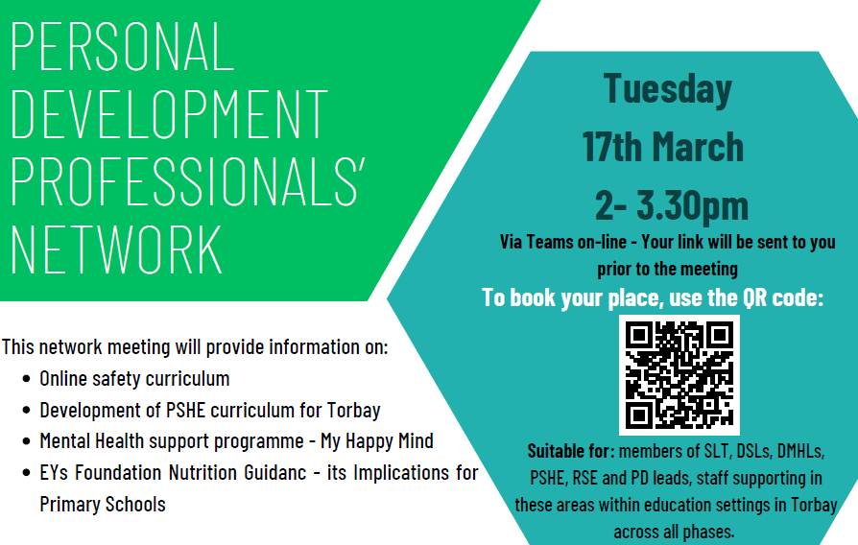
PDPN
Welcome
Spring 2026
Please take a moment to grab a coffee and be ready to join in with the discussions throughout today’s PDPN

Slide 2
Agenda
Agenda Item | Presenter | Time allocation
Place 2 Be – Learning Together for Mental Health | Tom Young | 10 minutes
My Happy Mind Suicide Prevention Resources | Olivia Jones | 15 minutes
EYs Nutrition Guidance and what it means for primary schools Bite Back for secondary schools | Vicky Glanville | 10 minutes
Online Safety Curriculum Development of PSHE curriculum for Torbay | Kim Hartnell | 45 minutes
AOB | All | 5 mins

Slide 3
Place 2 Be - Learning Together for Mental Health Trial
Tom Young

Slide 4
My Happy Mind
Suicide Prevention Resources
Olivia Jones

Slide 5
Early Years Foundation Nutrition Guidance
- what it means for schools
Bite Back for secondary schools
Vicky Glanville

Slide 6
RSHE - 2026
RSHE has two elements: - Health and Wellbeing - Relationships Education

Slide 7
Health and Wellbeing
General wellbeing
Wellbeing online
Physical health and fitness
Healthy eating
Drugs, alcohol and tobacco
Health protection and prevention
Personal safety
Basic first aid
Developing bodies

Slide 8
Relationships Education
Families and people who care for me
Caring friendships
Respectful, kind relationships
Online safety and awareness
Being safe

Slide 9
Torbay Online Safety Curriculum
Share the curriculum (Review | Torbay Healthy learning)
Time to explore the Online Safety curriculum
Notes:
https://www.healthylearningtorbay.co.uk/themes/pdpn/review/

Slide 10
Torbay and Devon Contextual Information
· 7% of males and 17% of females said they have been asked to send their picture to someone they don't know when online and 7% of males and 13% of females said they have been asked to meet someone they don't know.
· 83% of pupils said they have been given information or advice about staying safe online; 62% said it has been helpful.
· Of the 1664 pupils who said they have been given information or advice about staying safe online, 75% said it has been helpful.
· 1% of pupils said they don't spend time online (outside of schoolwork/homework), while 7% said they spend less than an hour online on a normal day.
· 64% of pupils said they spend at least 3 to 5 hours online (outside of schoolwork/homework) on a normal day.
· 22% of pupils said they spend 6 or more hours online (outside of schoolwork/homework) on a normal day.
· 69% of pupils responded that they go online for social media, while 67% said that they go online for gaming/playing games.
SHEU Report

Slide 11
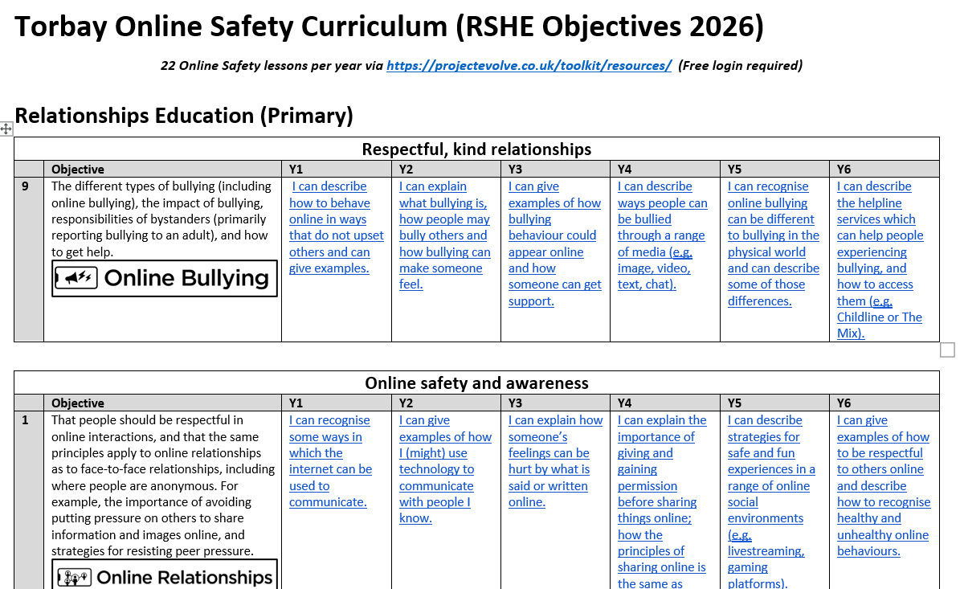

Slide 12
Breakout Rooms
Explore the Online Safety Curriculum
Reflect on how you may implement this curriculum in your school

Slide 13
Torbay PSHE Curriculum
Share the curriculum (10 mins)
Time to explore the Online Safety curriculum (10 mins)
Time for any feedback and development suggestions (5 mins)

Slide 14
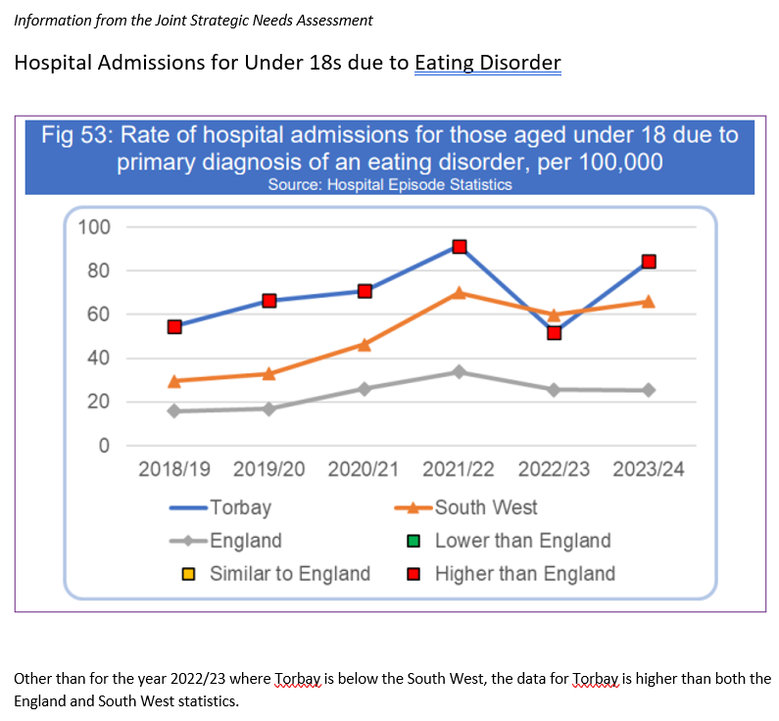
Torbay Contextual Information

Slide 15
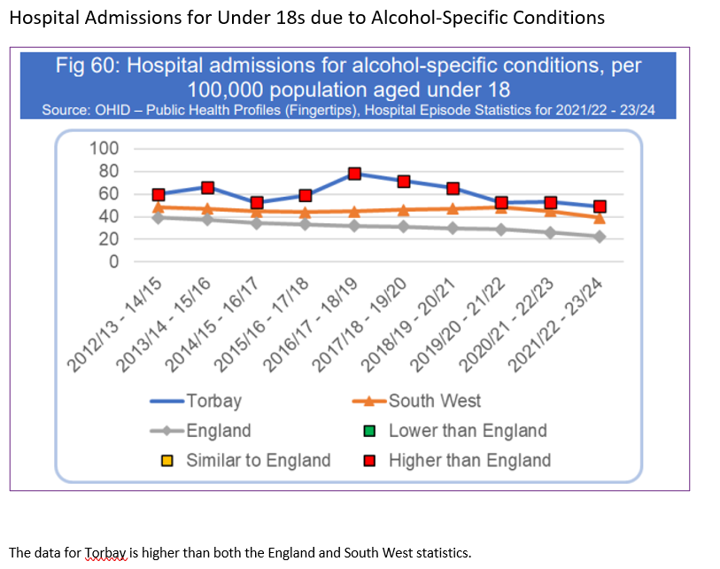
Torbay Contextual Information

Slide 16
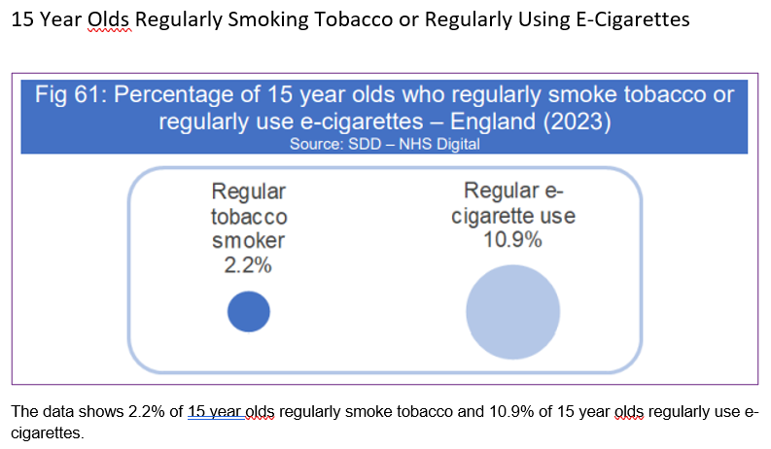
Torbay Contextual Information

Slide 17
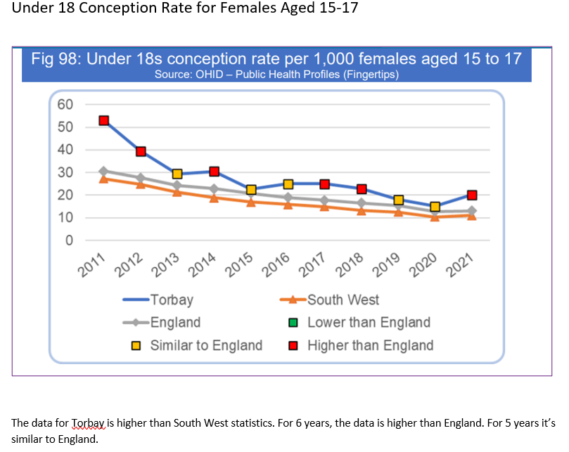
Torbay Contextual Information

Slide 18
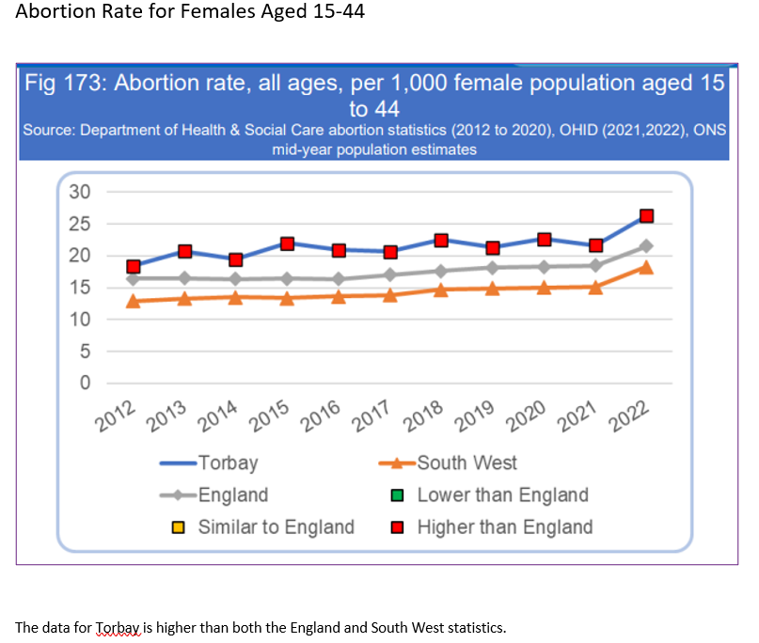
Torbay Contextual Information

Slide 19
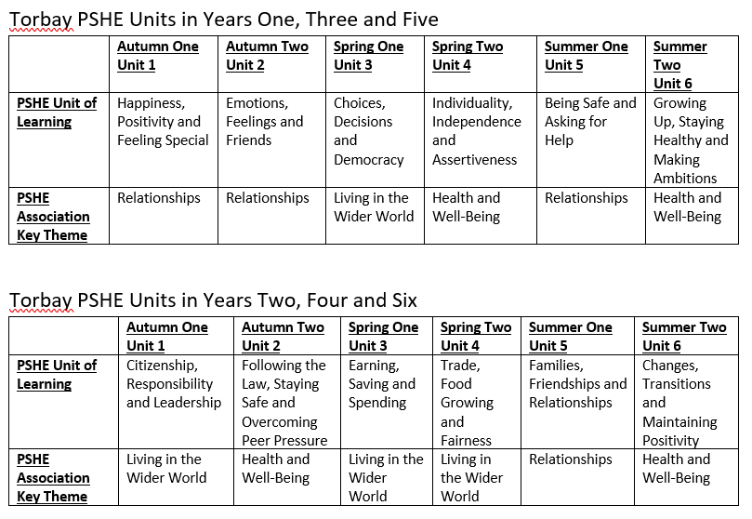
PSHE Curriculum Overview

Slide 20
Breakout Rooms
Explore the Online Safety Curriculum
Reflect on how you may implement this curriculum in your school
Consider any amendments you think may be appropriate

