Slide 1
My Happy Mind
Olivia Jones – Public Health Practitioner - All Ages Mental Health and Suicide

Slide 2

The picture…
1 in 5 CYP access mental health services (England)
Torbay EHE – 42% due to unmet MH needs (2023/2024)
Exclusion and suspension rate in Torbay around twice England rate (2023/4)
Torbay FSM eligibility 27%
Notes:
EHE- 215 out of 509 close to half due to unmet mental health need
50% of children who are excluded or suspended are in receipt of FSM
FSM- 27% eligible, so more likely to have a higher number who will experience mental health concerns
Darzi report- referrals to NHS children's mental health services have tripled from 2016 to 2024.
71% of the general public in the south west support a whole school approach to mental health and wellbeing according to CYPMHC

Slide 3
What is Myhappymind
A mental health and wellbeing curriculum (3-18).
Digital lessons, staff CPD, parent app, and physical resources.
Based on neuroscience, positive psychology & preventative mental health.
Whole‑system approach: Children + Staff + Parents.
Inclusive and trauma informed
Notes:
An NHS‑backed, evidence‑informed mental health and wellbeing curriculum for ages 3–18.
Tailored adaptations for neurodiverse learners, hearing/vision impairments, and trauma‑informed practice.

Slide 4


Future considerations

Slide 5
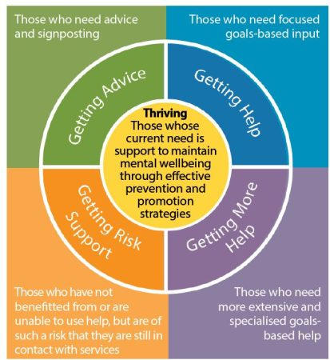
Myhappymind sits here

Slide 6
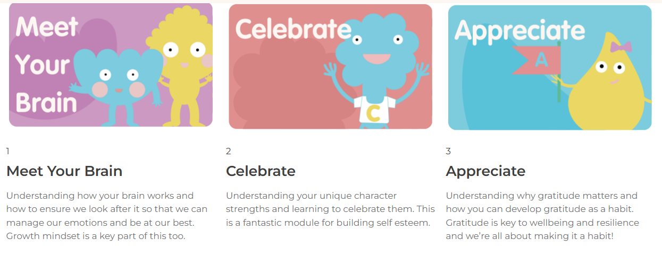
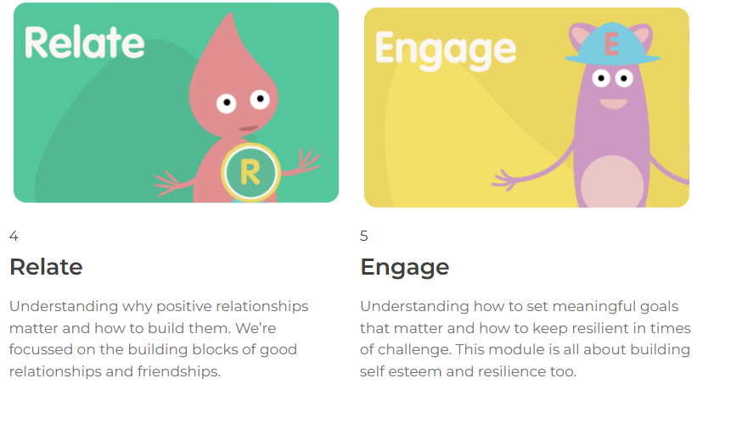

Slide 7
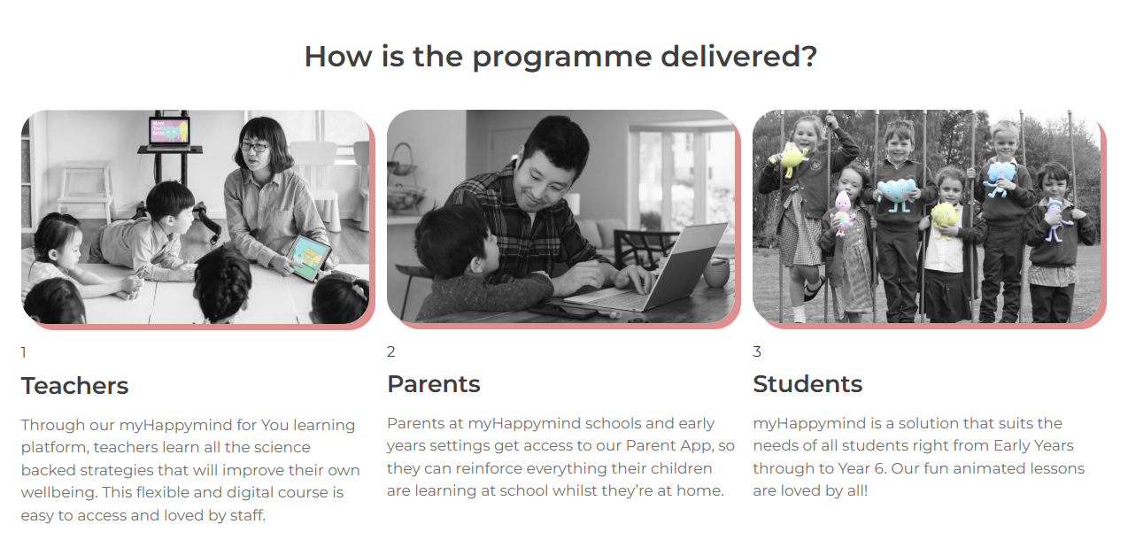

Slide 8
Includes
All digital and physical resources for class teachers to deliver the programme to their pupils
CPD-Certified Staff Wellbeing resources
myHappymind App for Parents
Dedicated Customer Service support for each school.
Impact reporting
Implementation support and project management
School readiness programme

Slide 9
System alignment
  Ofsted Framework (PD, safeguarding, inclusion, behaviour, attendance)
  NICE guidance & NHS Long Term Plan
  Best Start in Life (75% GLD target)
  i-THRIVE model
  Alignment with Darzi report
  Compliments MHST programme

Slide 10
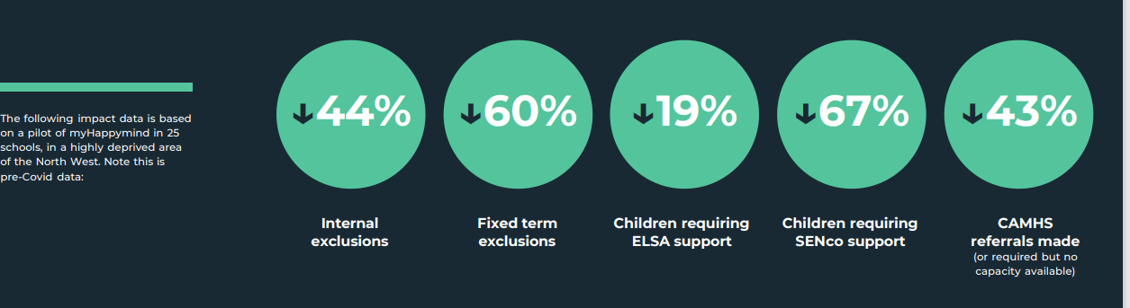
Results
Notes:
EMOTIONAL LITERACY SUPPORT ASSISTANTS
What’s Changing in Schools—And Why It Matters
From thousands of primary schools, one message comes through: prevention transforms culture.
💪 Teachers feel empowered – 99% are now having regular conversations—formal and informal—about pupils’ mental wellbeing each week.
🌱 Resilience is growing – 87% of teachers have seen an improvement in their children’s resilience and perseverance when trying to achieve their goals.
✨ Behaviour improves – Schools have reported up to a 60% reduction in external exclusions.
🌟 Staff wellbeing is rising – 98% of staff say they better understand their brains and how to support their own mental health.
🧠 Self-esteem is improving – 87% of teachers said they have seen the self-esteem and confidence of the children improving from using myHappymind so far.
🤝 Families are more involved – When parents are engaged through the app, schools report a dramatic increase in home-school consistency and support.
Embedding a mentally health future

Slide 11
Cost
£12pa per student
£1500pa minimum spend per school
TC funding will only cover 12 months for eligible schools (eligibility tbc)

Slide 12
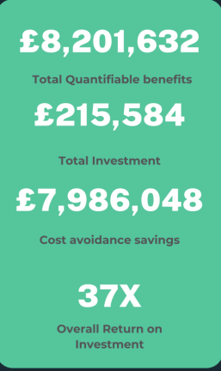
Hampshire local evaluation (2025)

Slide 13
ROI
Outcome | Prevented | Unit Cost | Cost Avoidance
CAMHS referrals | 618 | £3,784 | £2,338,512
MHST referrals | 1,230 | £1,250 | £1,537,500
SENCo referrals | 3,198 | £30.88/hr × 4 hrs | £395,017
Suspensions prevented | 560 | £4,300 | £2,408,000
Safeguarding workload saved | 1,148 | 2 hrs × £24.32 | £55,839
Attendance improved | 6,789 pupils | £43.21/day | £1,466,764

Slide 14
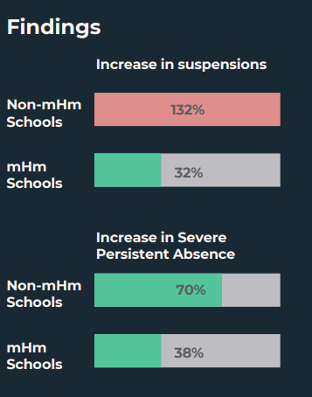
Portsmouth evaluation
Primary and early years offer.

Slide 15
Next Steps…
Torbay Council are seeking funding to support schools with this
Support will be based on needs of school and other interventions they have in place already
If interested and think this would benefit your school (exclusion, ELSA, CAMHS numbers) please be in touch
olivia.jones1@torbay.gov.uk

